Slide 1

China’s Holdings of U.S. Treasury Securities
Trends, Impacts, and U.S. Response

Slide 2
Introduction – Why This Matters
China has long been a major holder of U.S. Treasury securities.
Recent years have seen a steady reduction in holdings.
Today’s focus: historical trends, market impact, and U.S. response.

Slide 3
Historical Overview
2013 peak: ~$1.317 trillion
2025: ~$760.8 billion
42% reduction over a decade
China’s share fell from 14% to under 3% of foreign-held Treasuries

Slide 4
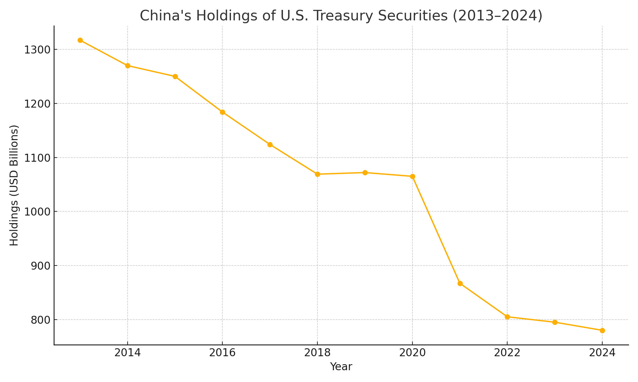
China’s U.S. Treasury Holdings (2013–2024)

Slide 5
Why Is China Selling?
Reserve diversification
Currency stabilization (supporting yuan)
Reducing geopolitical risk
Not a dump – it’s gradual and measured

Slide 6
Market Impact
Increased Treasury supply raises yields
April 2022: 10-year yield rose from 2.4% to 2.9%
Late 2023: yields approached 5%
Private investors are filling the gap

Slide 7
U.S. Economic Effects
Higher interest rates across economy
Impact on mortgages, loans, credit
Potential for mild inflation via dollar effects

Slide 8
U.S. vs Foreign Holdings
2024: U.S. domestic investors hold ~78% of Treasuries
Foreign investors hold ~22%
Greater internal reliance on debt financing

Slide 9
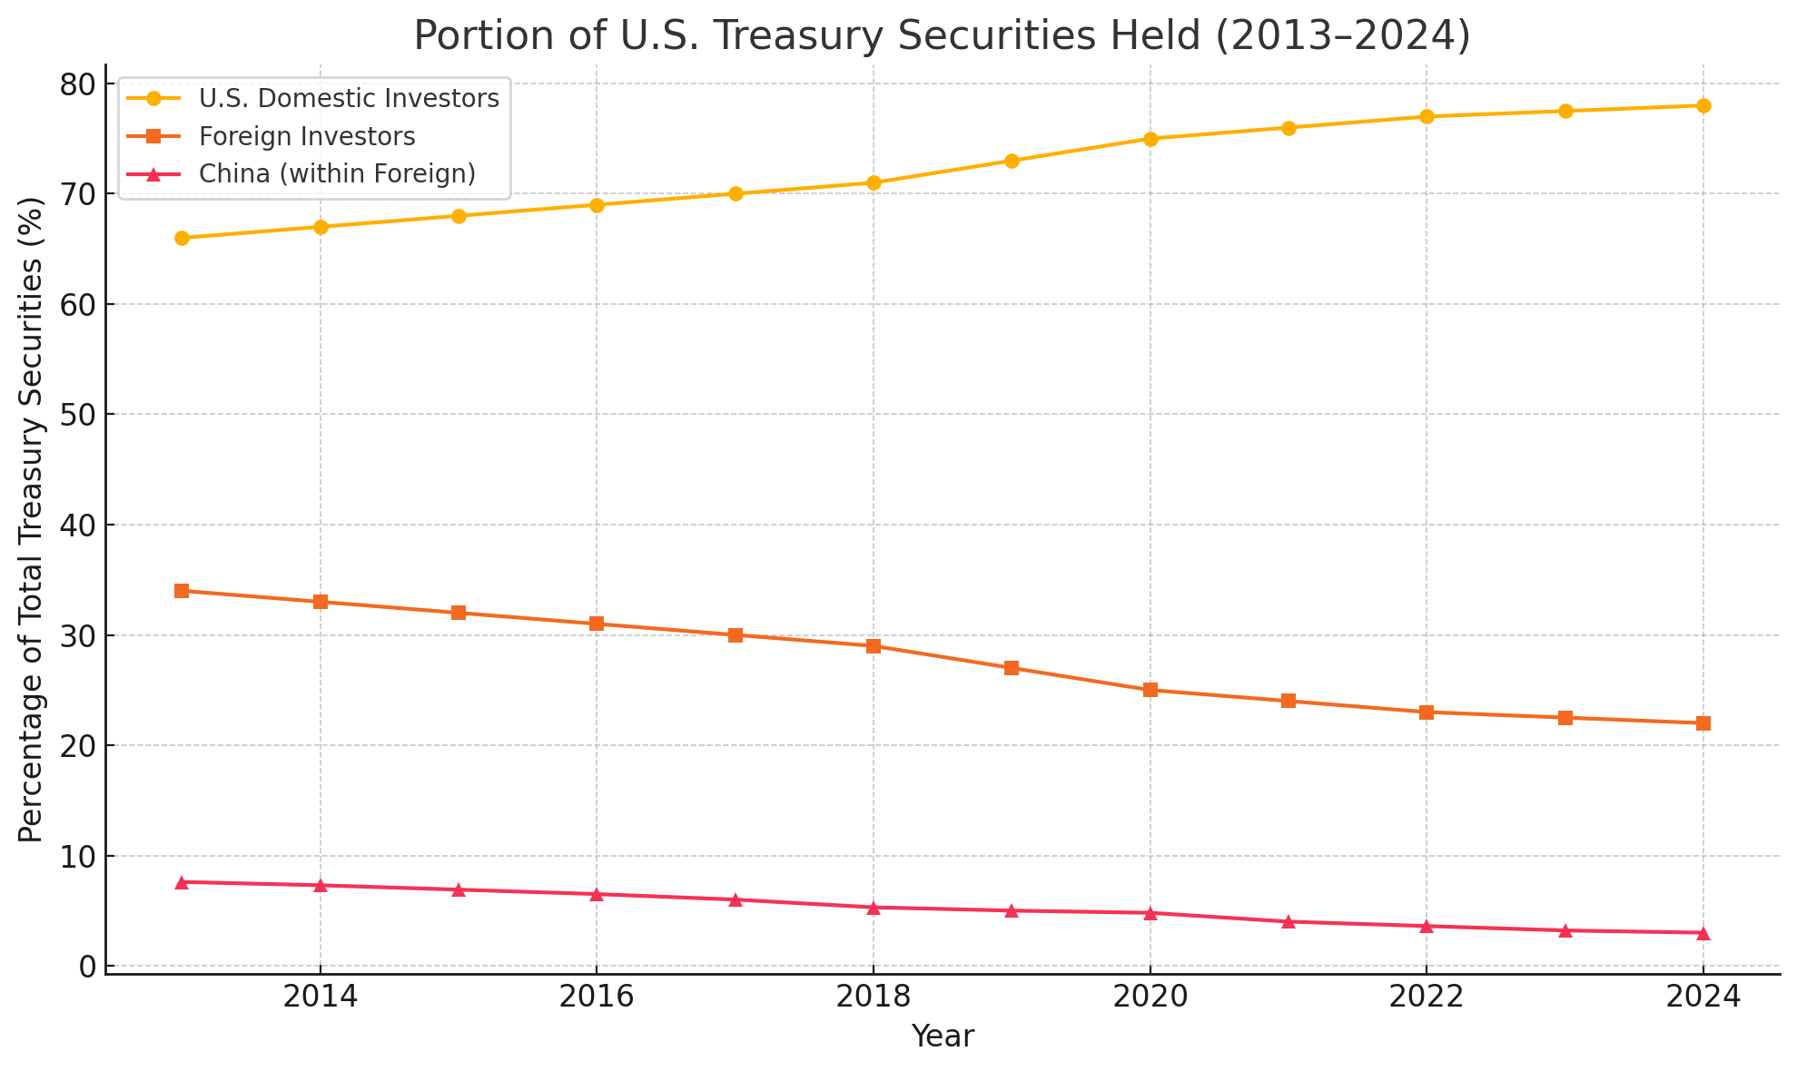
Portion of US Treasury Securites held
(2013–2024)

Slide 10
Is the U.S. Worried?
No signs of panic from officials
Tools in place: repo facilities, Fed support
China also has incentives to avoid disruption

Slide 11
Conclusion
China’s holdings fell significantly but gradually
Markets absorbed the change without chaos
U.S. remains confident but vigilant

